Slide 1
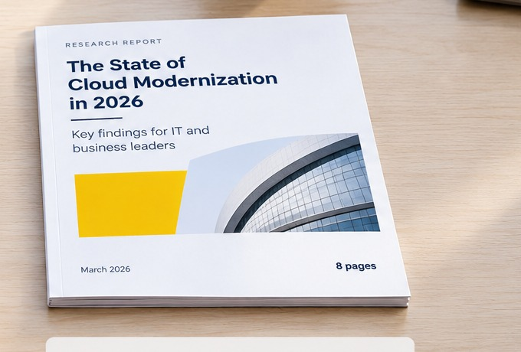
EDITABLE WORKBOOK
B2B Whitepaper
Planning Brief
Plan the argument, evidence and reading experience before design begins.
US A4 · PORTRAIT
FULLY EDITABLE
3PAGES
WORKSHEETS
Planning brief · Evidence map · Reuse plan
A pre-design tool for research-led B2B reports and whitepapers.

Slide 2
WORKSHEET 01
Whitepaper planning brief
Use this page to settle the decisions that should already be clear before layout work starts.
RESEARCH QUESTION
Principal findings
What is this report genuinely trying to answer?
List the 3–5 findings that justify asking someone to read the report.
PRIMARY AUDIENCE
1
<placeholder>
Who needs to understand or act on the findings?
PURPOSE OF THE REPORT
2
<placeholder>
What should readers understand, decide or do after reading?
3
<placeholder>
FINAL FORMAT
PDF, web summary, both, or another format?
4
<placeholder>
Before design begins
Research question, findings, evidence and decision owner should already be known.
EDITORIAL DECISION OWNER
Who can resolve scope, wording and qualification disputes?
Why this page exists
Design can improve hierarchy, navigation and comprehension. It cannot repair weak evidence or decide what the report is actually trying to say. Use this page before content moves into layout.
02
WORKSHEET 01 · PLANNING BRIEF

Slide 3
WORKSHEET 02
Findings and evidence map
Keep each finding attached to the evidence and qualifications needed to interpret it correctly.
Finding | Evidence / source | What it establishes | Qualification | How it appears
State the finding in one sentence. | Survey, interview, dataset or source note. | What can you say with confidence? | What must remain qualified? | Chart, table, quote, diagram or text.
State the finding in one sentence. | Survey, interview, dataset or source note. | What can you say with confidence? | What must remain qualified? | Chart, table, quote, diagram or text.
State the finding in one sentence. | Survey, interview, dataset or source note. | What can you say with confidence? | What must remain qualified? | Chart, table, quote, diagram or text.
State the finding in one sentence. | Survey, interview, dataset or source note. | What can you say with confidence? | What must remain qualified? | Chart, table, quote, diagram or text.
Standalone finding test
Would the finding still make sense if somebody copied it into another deck, email or social post without the rest of the report? If not, the source, timeframe, definition or qualification may need to travel with it.
03
WORKSHEET 02 · FINDINGS & EVIDENCE

Slide 4
WORKSHEET 03
Distribution and reuse plan
A whitepaper rarely stays inside the PDF. Decide where findings will travel and what context needs to travel with them.
PDF/ full report
Complete methodology
Linked navigation
Full source notes
Web summary
Searchable summary
Contextual links
Updateable content
Presentations
Extractable findings
Readable charts
Source attached
Sales/ campaign
One finding per asset
Qualification retained
Link to source
Context that should travel with a finding
Check the pieces that must stay attached when a finding leaves the report.
Source
Timeframe
Definition
Comparison
Qualification
Reuse notes
PRIORITY CHANNELS
OWNER/ APPROVAL
Where will the report and findings be used first?
Who verifies the reused finding before publication?
NOTES FOR DESIGN AND PRODUCTION
Any accessibility, format, export, brand or handoff requirements that should be known before production begins?
04
WORKSHEET 03 · DISTRIBUTION & REUSE

